Slide 1


HEATER BOTTLE
TEAM MENTOR:
MR. VIBIN MAMMEN VINOD
TEAM MEMBERS:
BHOOVITHA S
DHANUSHKUMAR M P
AMIRTHAVARSHINI SA

Slide 2
PROBLEM STATEMENT
Currently the necessity of hot water is increasing due to the spread of various diseases. This younger generation are not getting enough immune power to overcome diseases as they are not taking nutritious foods.
They get easily affected due to climate change, drinking different area water etc. This change in usual drinking water easily affects the children, teenagers, adult and all age people.
To overcome this worst situation people are in need to carry hot water for them and for their family wherever they go.

Slide 3
PROPOSED SOLUTION
To solve this major problem, “HEATER BOTTLE” is introduced. It is modification of flask and the main function this bottle is, it heats the water automatically.
Firstly, cover the nichrome wire by using sleeve. Now wound the sleeved nichrome wire around the bottle.
Next give the DC supply with the rating of 20V and 2 amps along the both ends of the nichrome wire. The main function of this nichrome wire is to covert the electricity into heat. This heat passes to the water by heating the steel. It can reach 60 degree Celsius within 10 to 15 minutes.
The specialty of this heater bottle is that, user can fix the temperature of the water as per their convenience. Once the fixed temperature is reached the bottle intimates the user with a buzzer sound.
The DC supply is given by means of battery and this battery is rechargeable. Users can recharge it once after the battery is completely drained. They can recharge it three to four times.

Slide 4

WORKING

Slide 5
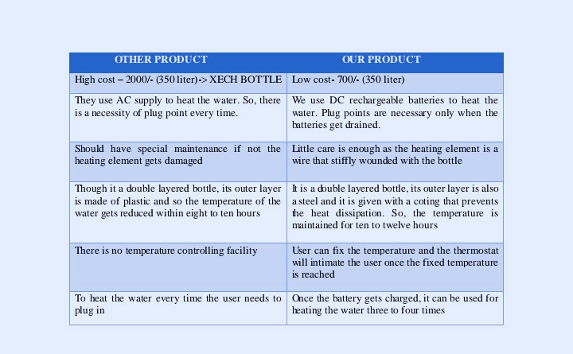
NOVELTY

Slide 6
APPLICATION
The main reason for choosing this project is to help all age people by providing instant hot water. This is mainly to avoid getting sick often.
This project plays a major role in improving the health of people. This reduces the pain of parents in order to protect their children from getting affected by fever, cough and cold often.
When a person gets admitted in a hospital or when a person is working in a company, school or college where there is no facility of hot water, this product is very much helpful.
When a person travels a long distance, this product plays a major role in maintaining the user’s health and also their family and friends.
Our target customers are middle class people, High class people, goods shops, malls etc. If this product gets launched then this will surely create a great positive impact among people. The only reason is it can solve the major problem faced by the people in various location. And also, this product costs less compared to the existing product.

Slide 7
SUMMARY
Currently the necessity of hot water is increasing due to the spread of various diseases like flu, chickenpox, typhoid etc. The younger generation easily get affected due to climate changes, drinking different area water etc. To overcome this worst situation people are in need to carry hot water for them and for their family wherever they go.
To solve this problem schools, colleges, hospitals, companies are having “WATER DOCTOR” in their workplaces. But in normal places like markets, bus stand, temples, railway station and theatres do not have such facility that provide hot water. Even in some hospitals they don’t have hot water. This makes people to suffer a lot. Moreover, the need of hot water mainly affects people while they are in travel.
The people who are travelling long distance are suffering more. The main problem is we can store hot water only with the help of flask but carrying three to four flask is very hard for people.
The single flask of hot water is not enough for a person who is sick and travels long distance. Nowadays, government have started implementing “WATER DOCTOR” everywhere. But it does not help while people while they are in travel. To solve this major problem, “HEATER BOTTLE” is introduced.
It is the modification of flask and the main function of this bottle is that, it heats the water automatically. To make this effective product an 6meter nichrome wire, 6meter sleeve, W1209 (thermostat), a bottle, DC supply is needed. The Nichrome wire is wounded around the bottle and this is responsible for the conversion of electricity into heat.
This heat can be maintained for ten to twelve hours. The DC supply with the rating of 20V and 2 Amperes of current are given along the both ends of the nichrome wire. It can reach 60 degrees Celsius within 5 to 10 minutes. This help people in a efficient way by providing hot water instantly. The specialty of this heater Bottle is that, user can fix the temperature of the water as per their convenience. The DC supply is given by means of battery and this battery is rechargeable.

Slide 8
CONCLUSION
Finally with this product we can travel anywhere at anytime without thinking of scarcity of hot water. Especially for children and patient it will be very useful.
Even in small clinic we can't able to find the water doctors so in that situation this water bottle will help us and made us comfort when we’re sick.
So that with hope of success of this product we are concluding that if this project come as complete product it will definitely be a useful one for every human in this world.

Slide 9
THANKYOU
“An investment in knowledge
pays the best interest”

